Slide 1
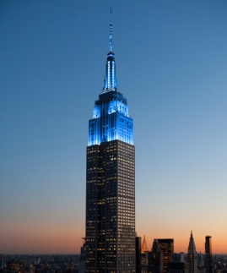
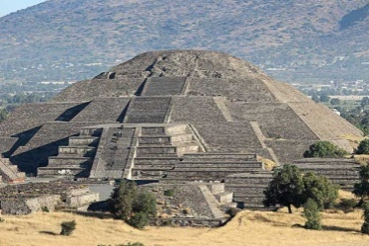
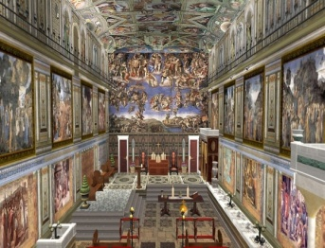
UNAM CULTURAL EXCHANGE PROGRAM
Travel abroad with students from other countries and cultures. Visit the history that is captured in the monuments and buildings around the world.
NEW YORK
There are uncountable places to visit and things to do in New York!
Empire State Building
The Empire State Building is located in Midtown Manhattan; it is found on Fifth Avenue. The skyscraper was completed in 1931 and it was introduced by president Hoover in that year. It is an admired building since it represents the fifth-tallest building in the United States and it has been entitled as one of the Seven Wonders of the Modern World by the American Society of Civil Engineers. The skyscraper is visited by over 2 million people every year and a spectacular view is appreciated from the observatories that are located on 86th and 102nd floors.
Teotihuacan, Mexico
A wonderful destination in Mexico is found in Teotihuacan where the Pyramid of the Sun is found.
The pyramid was built more than a thousand years ago in central Mexico. It is located approximately 50 kilometers from Mexico City and a population of over a hundred thousand was settled in this place. Although the Aztecs lived there, its origin is not well acknowledged; scientists and scholars have not been able to exactly determine which culture built the city; yet it was inhabited by different cultures such as Zapotec, Mixtec, and Maya.
The Sistine Chapel in Italy
The Sistine Chapel in Italy was built between 1473 and 1481 during the Pope Sixtus’s administration; the amazing works of art on the ceiling were illustrated by Michelangelo. Before asking Michelangelo to paint the ceiling of the chapel, other artists were requested to do the work. Botticelli, Perugino, Ghirlandaio, and Rosselli were asked by Pope Sixtus IV to portray biblical stories on the walls. The Sistine Chapel is now visited and valued by thousands of people every year. People are marveled by its amazing works of art.

